Slide 1
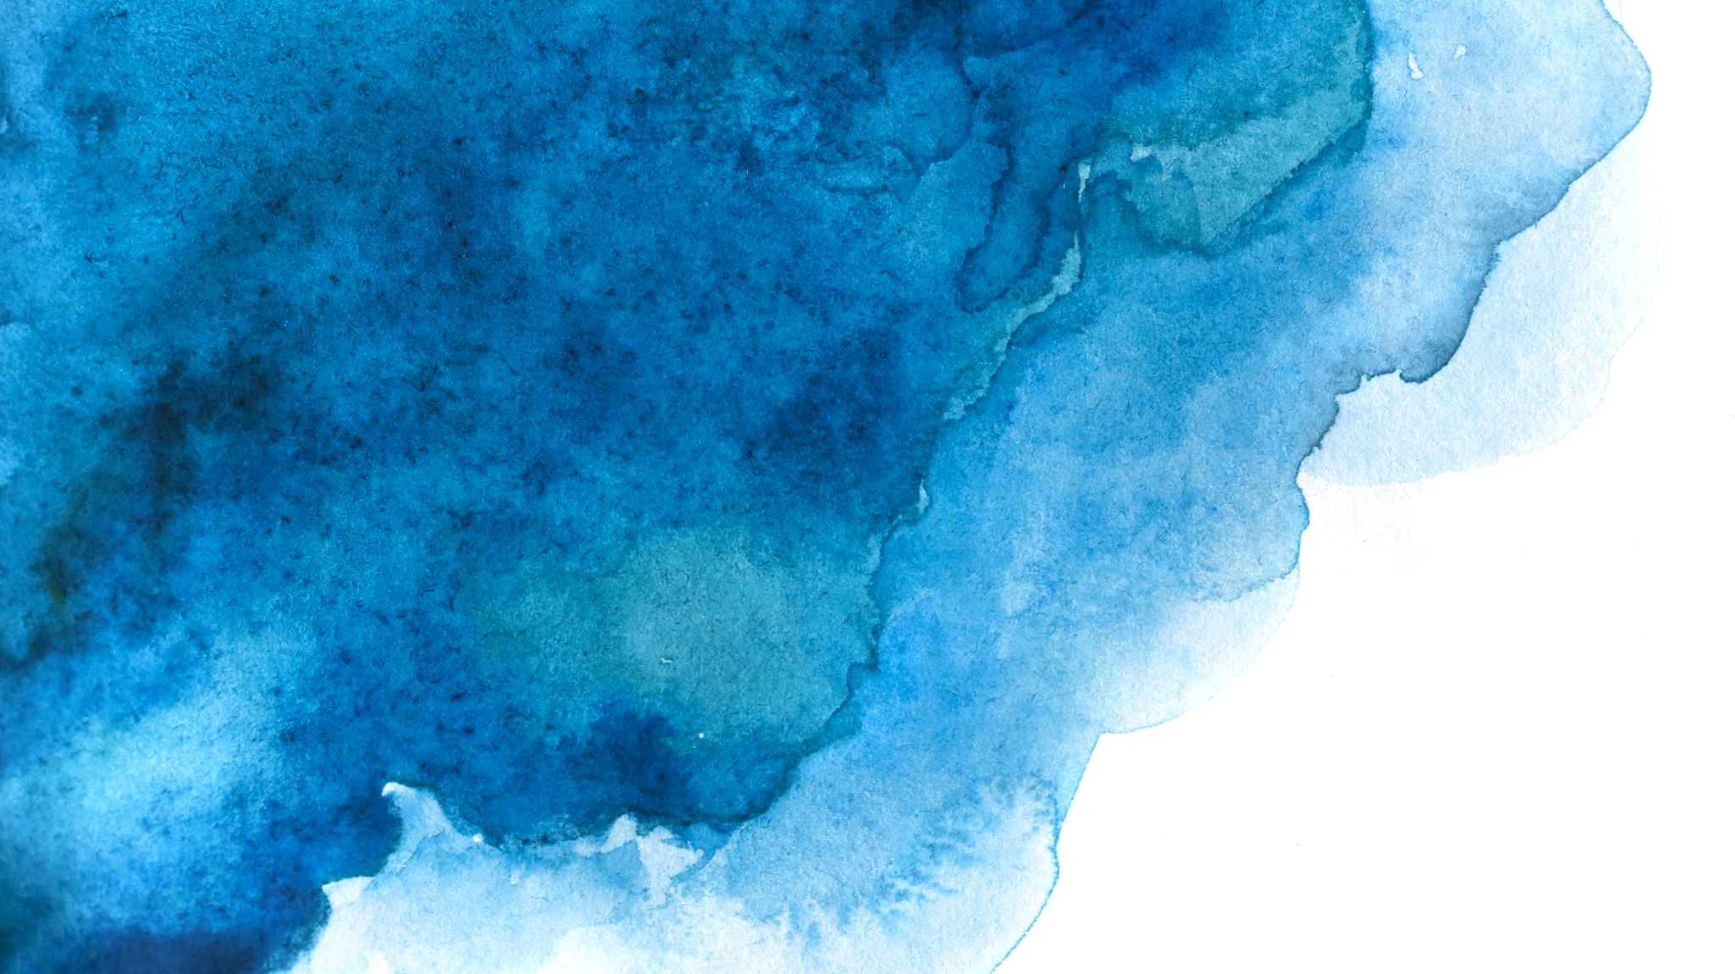
Vehicle Detection Using Image Processing
Presenter: Kashish Jain
Course: GRAD-695 Applied Project

Slide 2

Problem Statement & Motivation
Problem: Manual vehicle detection from images/videos is slow, inconsistent, and not scalable. There is a need for an automated, educational, and modular prototype to test and compare object-detection models.
Why it matters:
Real-world relevance for traffic, surveillance, and smart mobility research.
Demonstrates AI integration in full-stack systems (Flask + Angular).
Bridges classical computer vision and deep learning approaches.

Slide 3
Data & Method Overview
Input: Images/videos or live feeds
Output: Annotated frames with bounding boxes and detected plates
Datasets: COCO 2017 for evaluation and testing.
Upload (Frontend)
Flask API
Model Selection
Detection + OCR (OpenCV)
Download Results
Output Storage

Slide 4
AI & Research Tools: Choices & Workflow
Category | Tool/Library | Rationale / Trade-offs
Backend | Flask + Flask-RESTX | Lightweight, modular API for rapid iteration
ML/Detection | OpenCV, PyTorch/TensorFlow | Balance between speed (Haar) and accuracy (CNN)
OCR | Tesseract | Open-source text extraction
Frontend | Angular + Bootstrap | Clean upload/download UI
DB | SQLite | In-memory metadata tracking
IDE/Automation | Jupyter, VS Code, Postman | Fast prototyping and API validation

Slide 5

Experiments / Engineering Milestones
Key Iterations:
Baseline: Haar Cascade for CPU-only prototype.
Upgrade: CNN model integration for better precision.
Full Stack Integration: Flask REST API + Angular frontend.
Evaluation: Added test cases TC1–TC6 (API, UI, performance).
Performance benchmarks:
Haar: 1-min 720p video ≤ 2 min CPU
CNN: slower but improved robustness
OCR: ~70 % accuracy under normal lighting

Slide 6
Obstacles & Resolutions
Challenge | Diagnosis | Resolution
CNN inference latency | CPU bottleneck | Downsample frames, reduced FPS
Unsupported file formats | Input validation missing | Added explicit checks + error handling
Frontend-backend sync | Payload mismatch | Swagger & Postman testing
Model weight issues | Corrupted files during testing | Re-initialized paths and checksum validation

Slide 7

Demo (Presented in executive session)

Slide 8
Risks, Limitations & Ethics
Limitations:
No GPU acceleration (CPU-bound prototype)
Not production-ready (single-user demo)
No real-time streaming optimization yet
Ethics & Compliance:
Plate-blur option for privacy
Not intended for surveillance use
Dataset licensed for academic research only

Slide 9
Impact, Roadmap & Next Steps
Impact:
Demonstrates end-to-end ML pipeline integration for education/research.
Foundation for scalable traffic analytics or smart-city prototypes.
Next Steps:
Integrate YOLOv5/YOLOv8 for faster inference
Deploy on GPU/Cloud
Add user authentication, access control
Expand to multi-camera live detection

Slide 10
References
References:
OpenCV Documentation
PyTorch/TensorFlow Libraries
COCO Dataset (2017)
Tesseract OCR
Flask & Angular Framework Docs

